Slide 1
DEVELOPMENT OF THE SKIN
Dr. Mbira

Slide 2
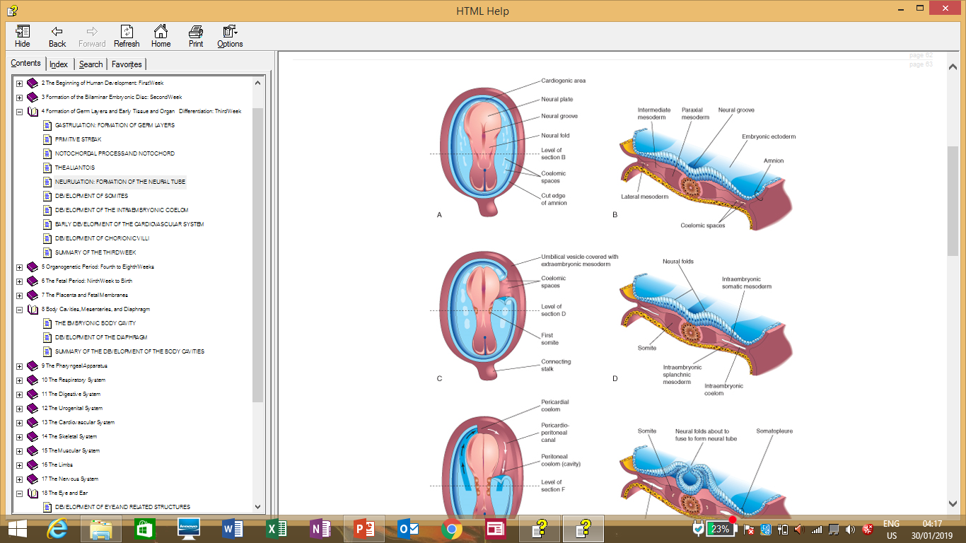
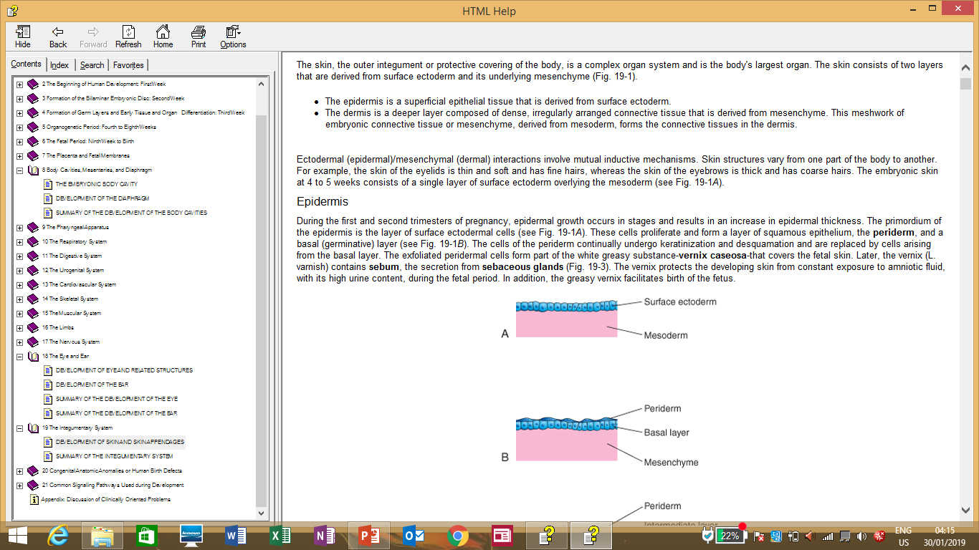
The skin is made up of 2 layers derived from the 2 outer layers of the embryo:
Epidermis – Surface ectoderm
Dermis - Mesoderm

Slide 3
Epidermis
The epidermis is a superficial epithelial tissue, while the dermis is deep to it and comprises dense irregularly arranged connective tissue that is derived from mesenchyme which is in turn derived from mesoderm.
The initial covering at 4 weeks is a single layer of surface ectoderm cells. By the 5th week, the single layer divides to form a thin layer of squamous cells called periderm on the surface and a deeper germinative layer.

Slide 4
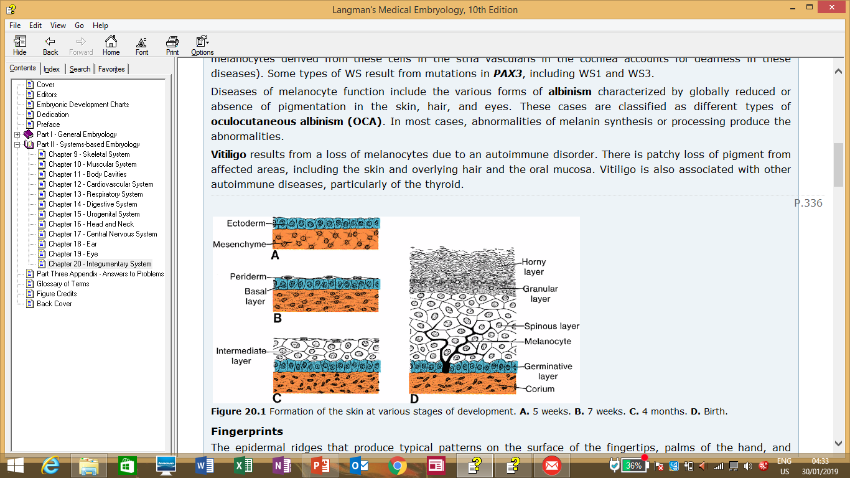
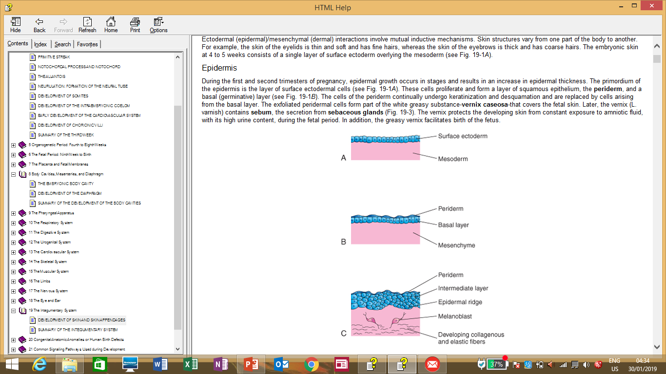

Slide 5
The basal layer acts as a generator of new cells which replace the layers above, while the periderm is keratinized and gets continuously shed off/desquamated.
By the end of the 4th month, the epidermis has 4 distinguishable layers:
Basal/germinative layer – generates new cells.
Spinous layer – thick with large cells.
Granular layer – smaller cells with keratin
Horny/cornified layer – Packed with many keratinized dead cells and gives the epidermis its tough consistency.
The desquamated cells which have now also started to contain sebum form a whitish layer on the surface of the fetus called vernix caseosa.
The vernix helps to protect the skin of the fetus from exposure and subsequent irritation from the amniotic fluid. Also later during birth, it helps to lubricate the baby’s body so that it can pass out easier through the birth canal.

Slide 6
By week 21, the periderm disappears and is replaced by the horny layer/stratum corneum.
The stratum germinativum forms projections/ingrowths into the underlying dermis which results in the epidermis having grooves or ridges. These ridges are established by the 17th week and form a permanent unique pattern especially in the palms and soles and thus are the basis of fingerprints.

Slide 7
In the 3rd month, neural crest cells migrate into the dermis and differentiate into melanoblasts.
The melanoblasts later migrate into the stratum germinativum where they differentiate into melanocytes which synthesize melanin pigment in melanosomes.
The melanocytes have dendritic processes which they use to transport the melanosomes into keratinocytes in the epidermis and this gives the skin its pigmentation.

Slide 8
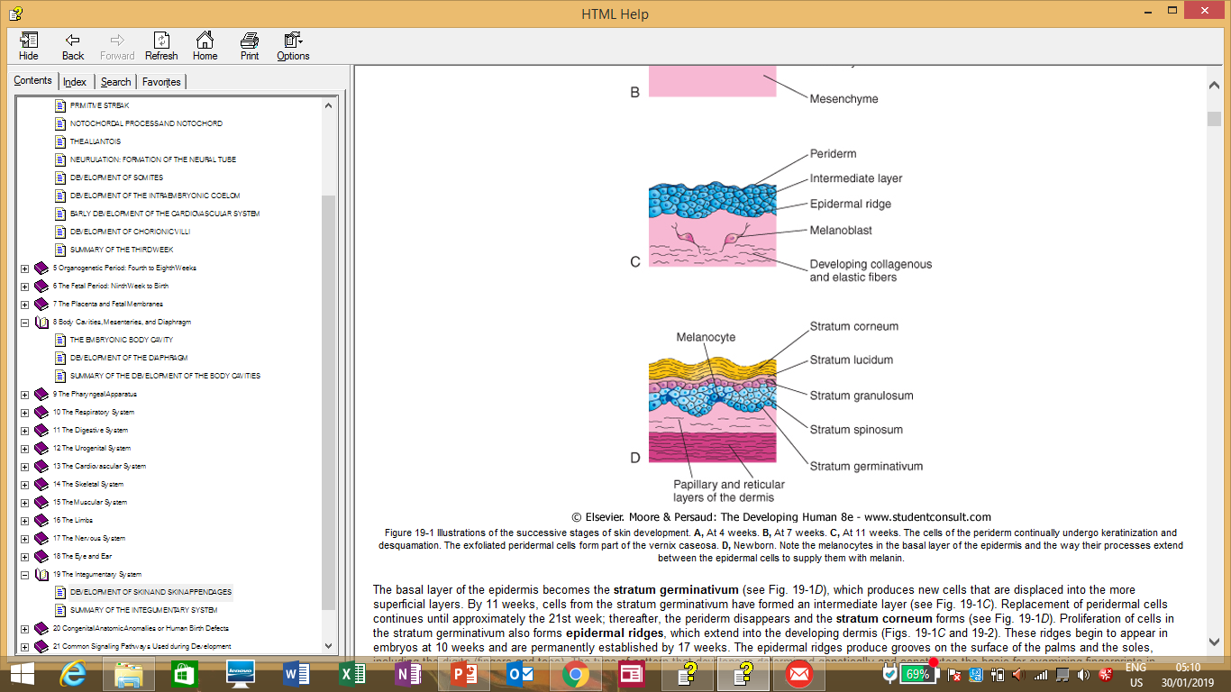
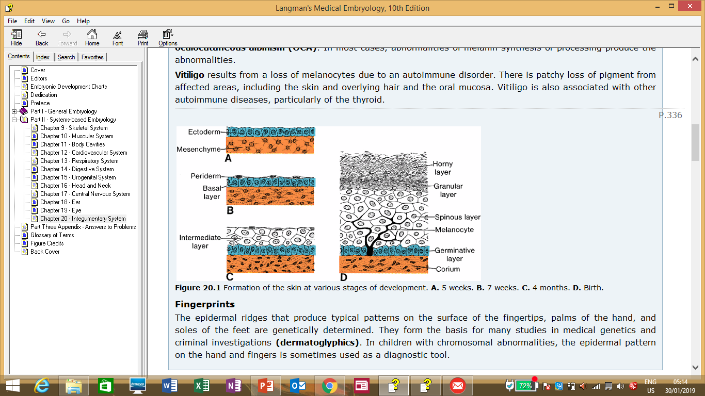

Slide 9
Dermis
Formed from lateral plate mesoderm somatic layer as well as dermatome of the somites.
As the epidermal ridges form, the dermis also forms projections into the overlying epidermis to form dermal ridges and in this way the 2 layers interdigitate with each other. In these ridges will form capillary tubes as well as sensory nerve endings.
By week 11, mesenchyme begins to form collagen and elastic tissue fibres.
The forming blood vessels are surrounded by muscular coats derived from surrounding mesenchyme differentiating into myoblasts and these then become arterioles and venules.
By week 12, the vasculature of the dermis is well established.

Slide 10
Skin glands
Sebaceous and sweat glands develop from the epidermis and grow into the dermis.
Sebaceous glands develop as buds from the root of the hair follicle and branch to form several alveoli. Later their central portions undergo apoptosis to form lumens and begin secreting sebum which they channel via the hair follicle to the skin.
There are a few sebaceous glands which are not associated with hair follicles and these are found in the glans penis and labia majora.
Sweat glands develop in a similar manner as epidermal buds that grow down into the underlyind dermis. They become long and coiled and cannulate acquiring a lumen. The coiled part becomes the secretory portion and the cells lining this part differentiate into secretory and myoepithelial cells.

Slide 11
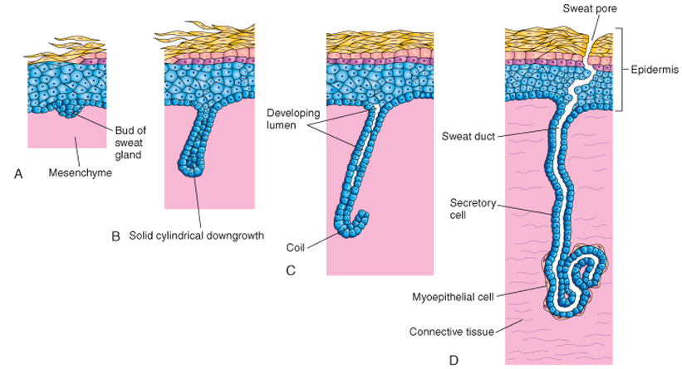

Slide 12
There are 2 types of sweat glands:
Eccrine – found throughout the body, begin their function soon after birth.
Apocrine – found in the axilla,areola of nipples, perineum and pubic areas. Associated with hair follicles. Produce an odorant sweat and begin to function in puberty.

Slide 13
Hair begins as hair buds which grow into underlying dermis and invaginate and then the cells in the invaginated end soon become spindle shaped to form a hair shaft.
The cells surrounding this hair shaft become cuboidal and form the hair sheath. The mesenchyme surrounding this hair bud form the dermal hair root sheath and some of the mesenchymal cells differentiate into the smooth muscle attached to the root called arrector pilli muscle.
As proliferation of the base of the shaft occurs, its tip is gradually pushed upwards until it emerges from the epidermal surface.
By the 3rd month, the first hairs can be seen in the eyebrow and upper lip regions in the rest of the body it takes slightly longer for hair to appear.

Slide 14
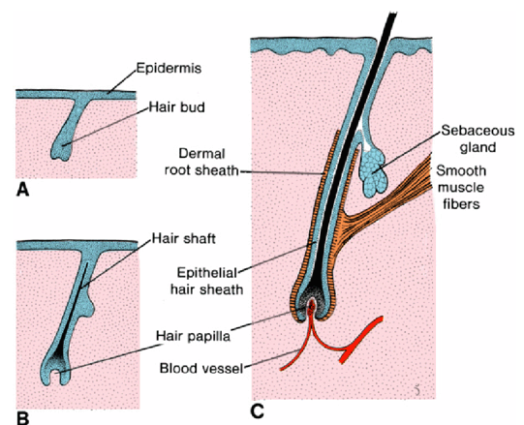

Slide 15
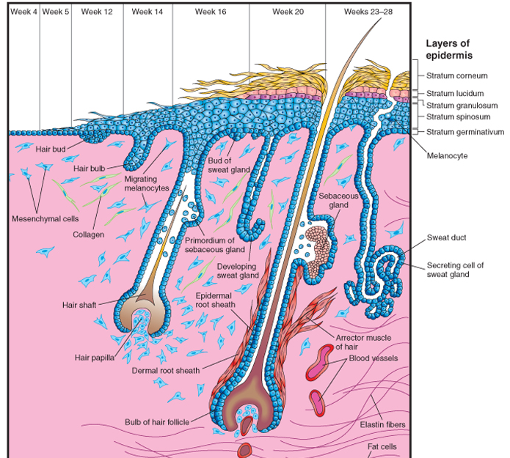

Slide 16
Sebaceous glands develop on the side of the follicle and secrete into the follicle.
The initial hair is very fine and delicate and is called lanugo. Soon after birth it begins to be replaced by the coarser hair that will be present for the rest of the life.

Slide 17
Mammary glands
They are modified sweat glands.
They begin as a line of thickened ectoderm; the mammary line/crest, extending from the region of the axilla to the groin at around week 7.
Soon after forming, most of this ridge disappears except at the thoracic region. Here, the ectoderm penetrates the underlying mesenchyme and forms 16-24 buds.
The buds later canalize to form the lactiferous ducts which open into a small epithelial pit, the site of the future nipple.
Soon after birth, the connective tissue under the pit proliferates, making it protrude as the nipple proper.

Slide 18
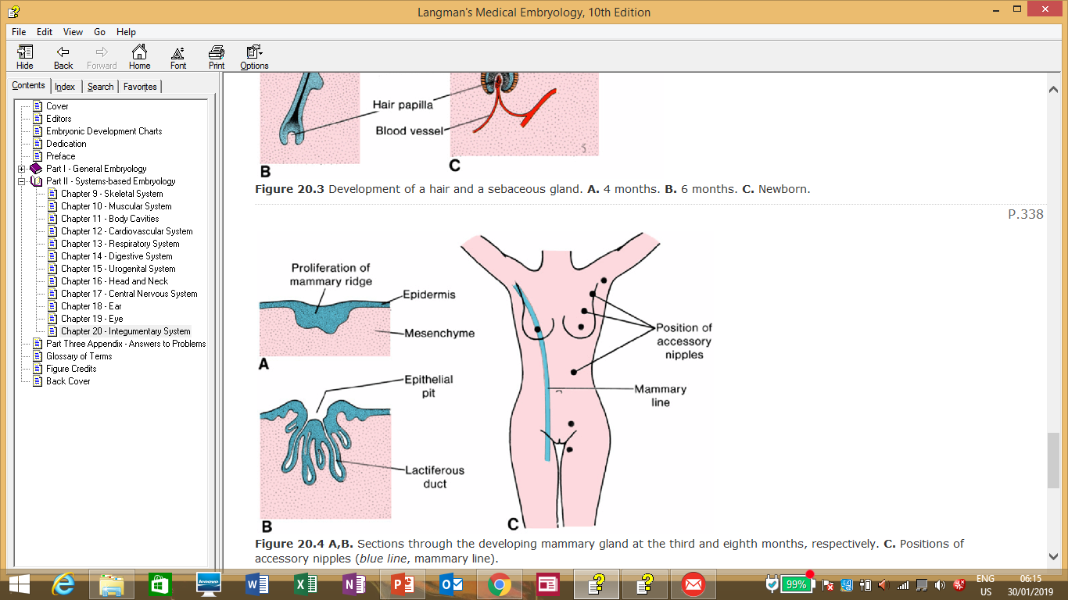
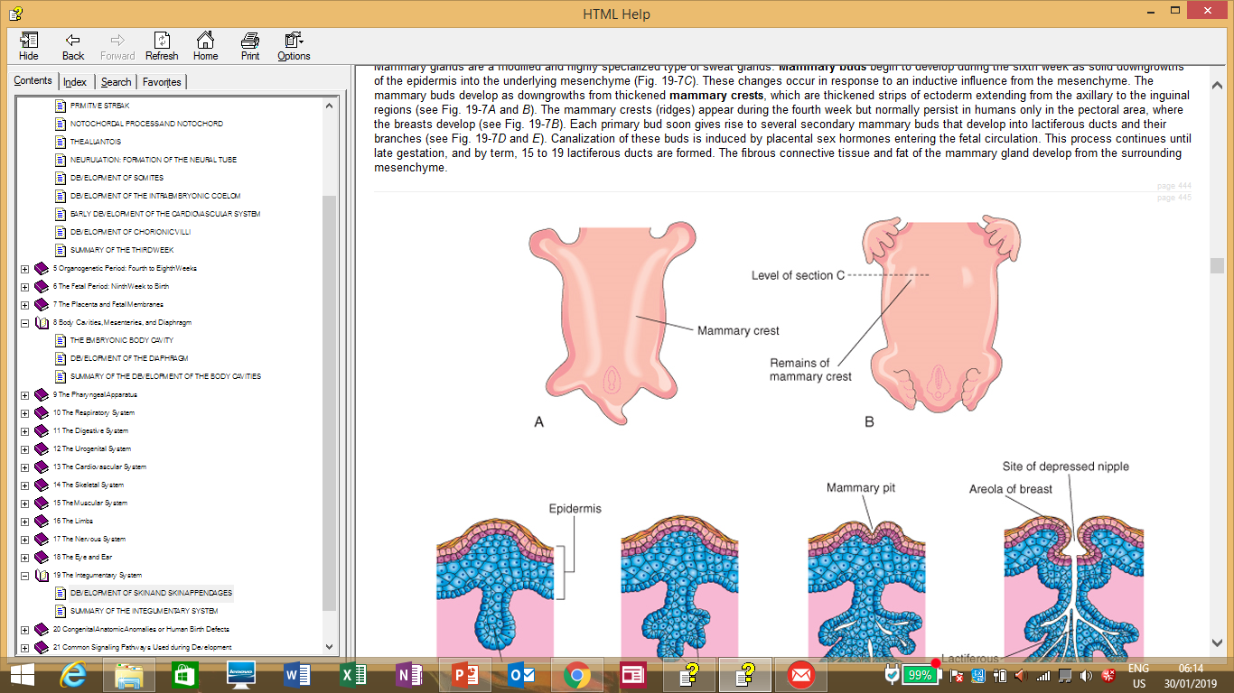

Slide 19
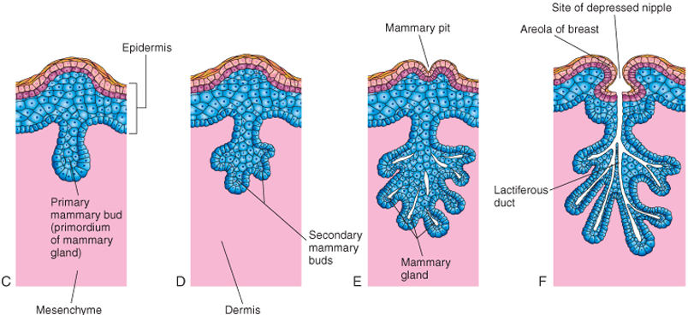

Slide 20
Nails
Begin to appear at the tips of digits by week 10.
The fingernails precede the toenails by 4 weeks.
A thickened part of the epidermis at the digit tip called the nail field appears. This nail field then migrates dorsally and is surrounded proximally and laterally by folds/ridges of epidermis called nail folds.
The proximal nail fold grows over the nail field and becomes keratinized forming the nail plate.
The nail plate becomes the nail and as it is growing, it is covered by a thin layer of epidermis called the cuticle/eponychium. The skin underneath the nail is called hyponychium.
Later, the thin covering skin degenerates exposing the nail but persists at the base of the nail as the cuticle.

Slide 21
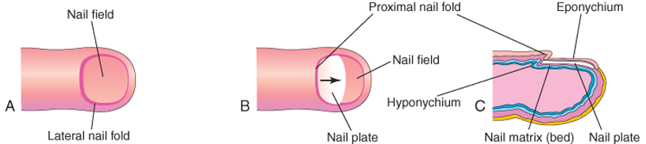
The fingernails reach the tips of the digit by week 32 while the toenails reach by week 36.

Slide 22
Ichthyosis
Hypertrichosis
Albinism
Athelia/amelia/hypoplastic breast or nipple.
Supernumerary nipples/breasts
Witch’s milk.

